Slide 1

Understanding Social Behavior at Scale
Anna Smith
9 May 2013
anna@bit.ly
@OMGannaks

Slide 2
INTRODUCTION
what is bitly
lexalytics topic integration at bitly
why we love it
where we use topics
search
realtime
audience analysis

Slide 3
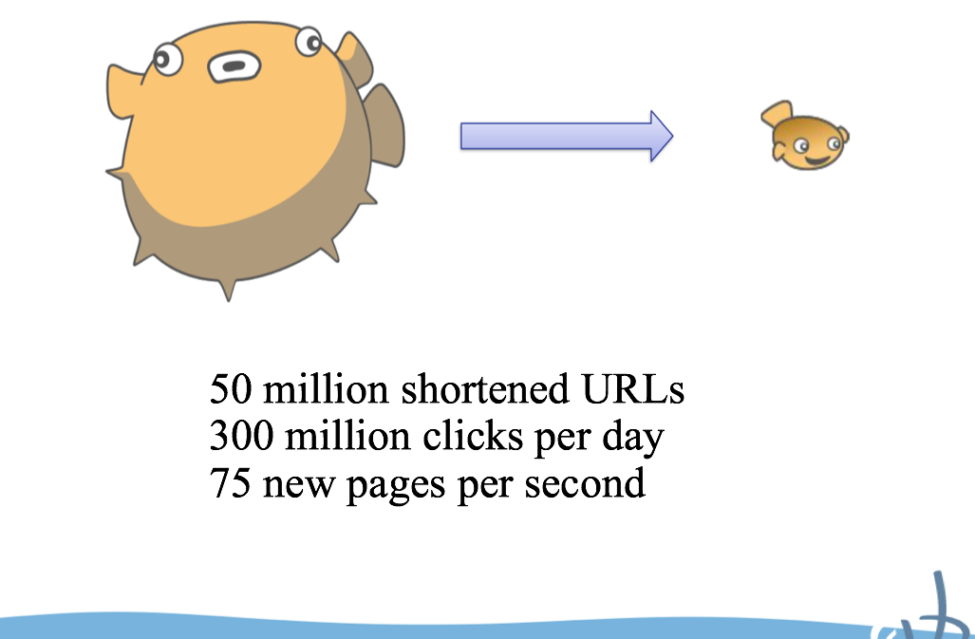
Notes:
we shorten links - can be anywhere on the internet: IM, emails, social networks, any page really

Slide 4
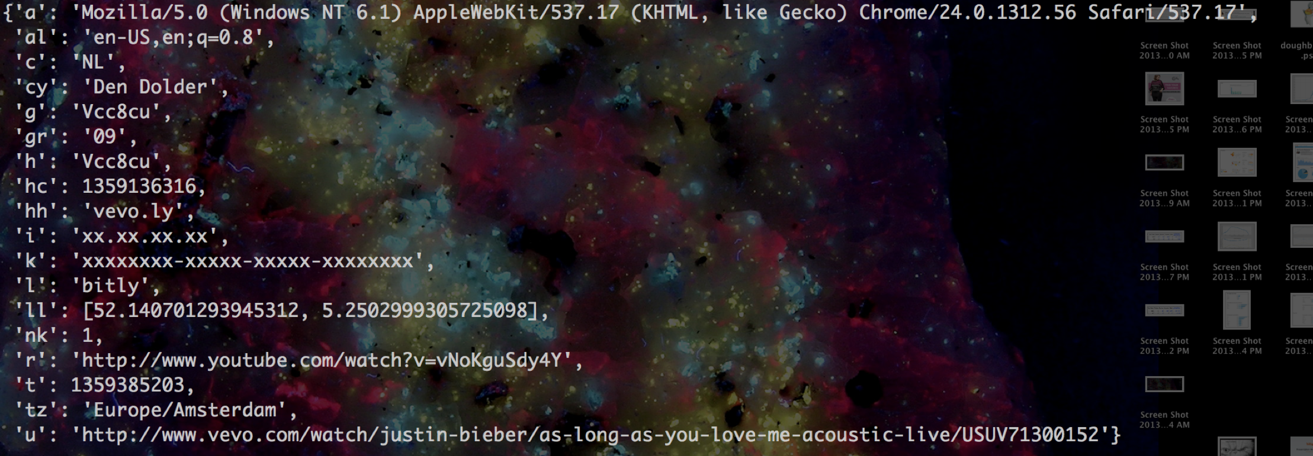
Notes:
have a lot of data

Slide 5

Notes:
stream data - 4 TB / month
hadoop - 300 TB raw -> 500 by EOY
Data! but what do we do with it?

Slide 6
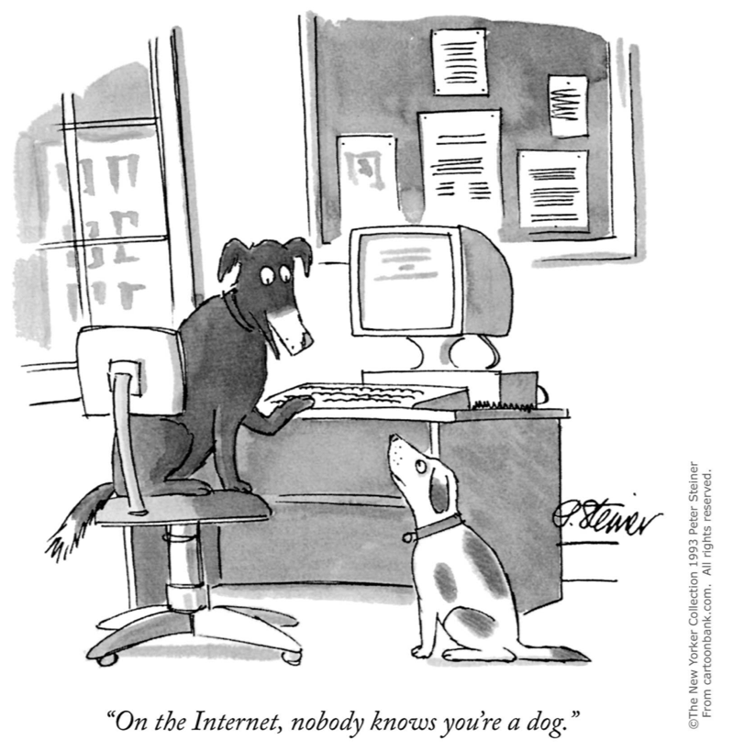
Notes:
human filter - ovi classification

Slide 7
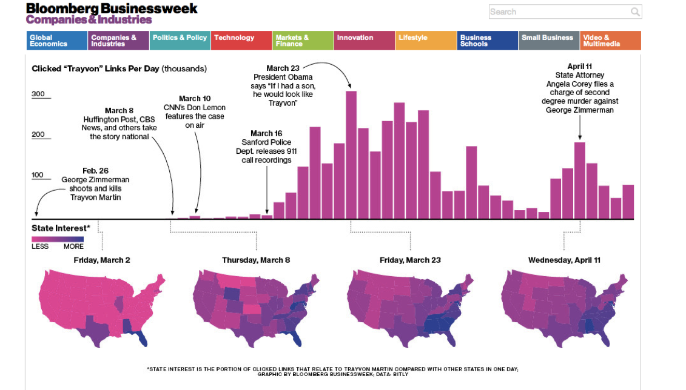

Slide 8
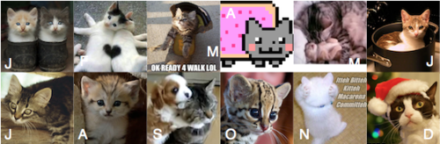
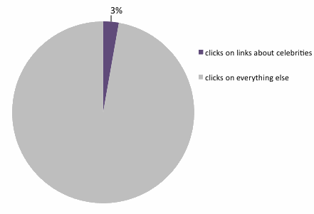

Slide 9
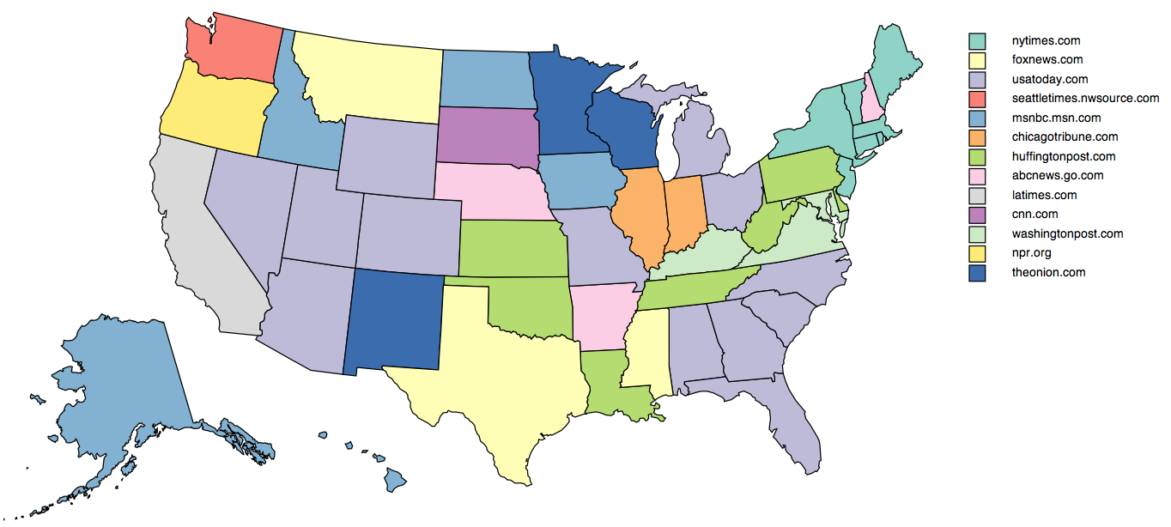
Media Map with Forbes
exploring how news websites are consumed across America more than the average
http://www.forbes.com/special-report/2012/media-map.html

Slide 10
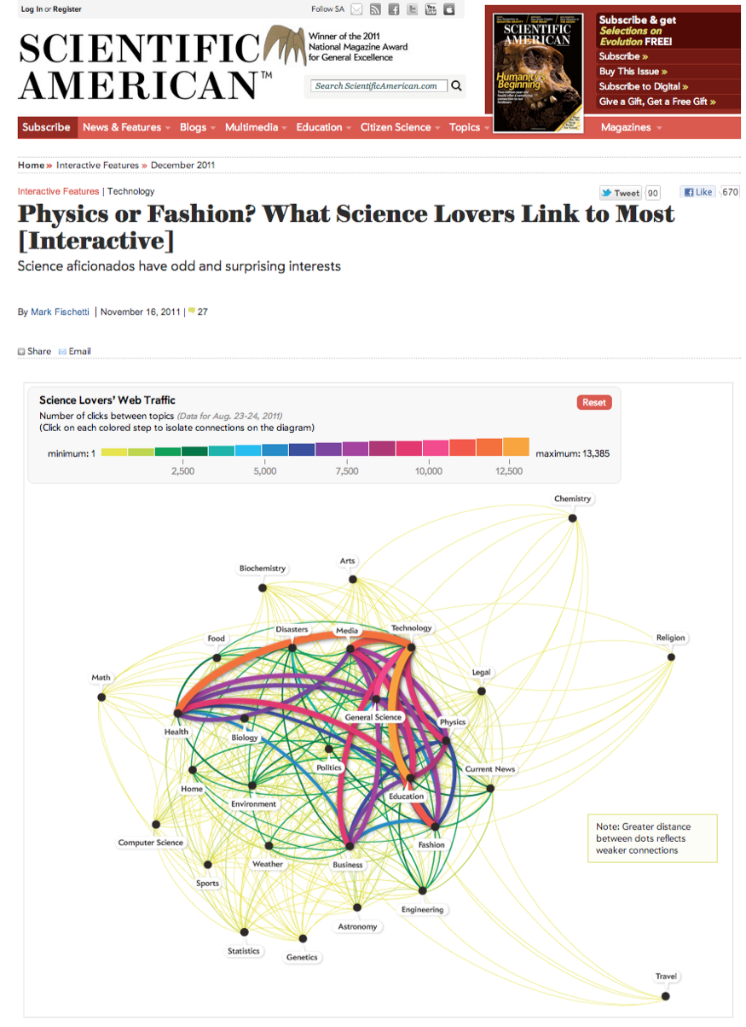

Slide 11


Slide 12

Notes:
is this really the internet?

Slide 13
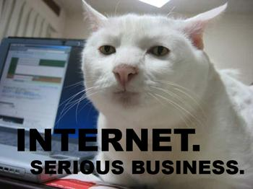
Notes:
no... we need to find this out. what are people really interested in and clicking on - understand "viral" and content
1. surface content, 2. understand your audience

Slide 14

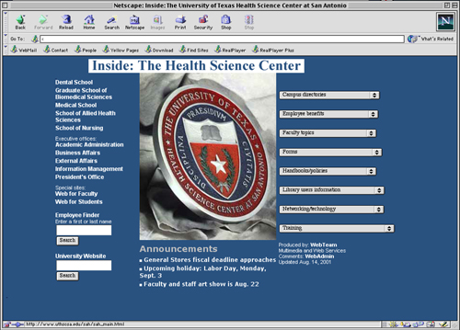

++
Notes:
scrape the urls that people are clicking on, send them off to salience and use the results to make bitly a better place

Slide 15
*click*
++
Notes:
scrape the urls that people are clicking on, send them off to salience and use the results to make bitly a better place

Slide 16
*click*
*content extractor*
++
Notes:
scrape the urls that people are clicking on, send them off to salience and use the results to make bitly a better place

Slide 17
*click*
*content extractor*
++
*products for YOU*
Notes:
scrape the urls that people are clicking on, send them off to salience and use the results to make bitly a better place

Slide 18
UNDERSTANDING CONCEPTS
use salience to define topics
these are topics we are interested in caveats!!!
must cover all possibilities of the internet
we want 100% coverage
AND low overlap between topics
Notes:
domain problem, because if you don't know what agriculture is, how are you going to define it?
also, wtf is the internet?!?!
working hard at this problem now (not just to align with advertisers)

Slide 19

WHAT WE LOVE
we own the taxonomy
we are scientists
we do not have to worry about 3rd party uptime
take responsibility for service
we scale the program
i want to know what is happening with my data
Notes:
github, depending on third parties is hard, not good if you want to be self sufficient and own your own problems (availability and reliability)
bitly way: we want it to do one thing and one thing well
It also gives us the ability to have well instrumented metrics, monitoring, and easy troubleshooting of our full stack

Slide 20


Slide 21
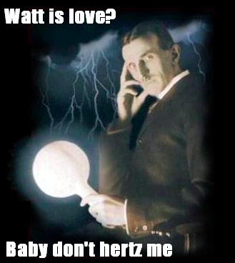

Slide 22
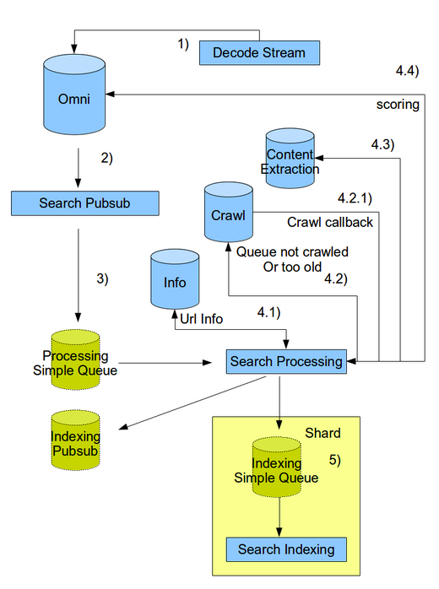
search (LUCENE)
Notes:
query bitly urls from the last 2 days (definitely doesn't look like google)

Slide 23
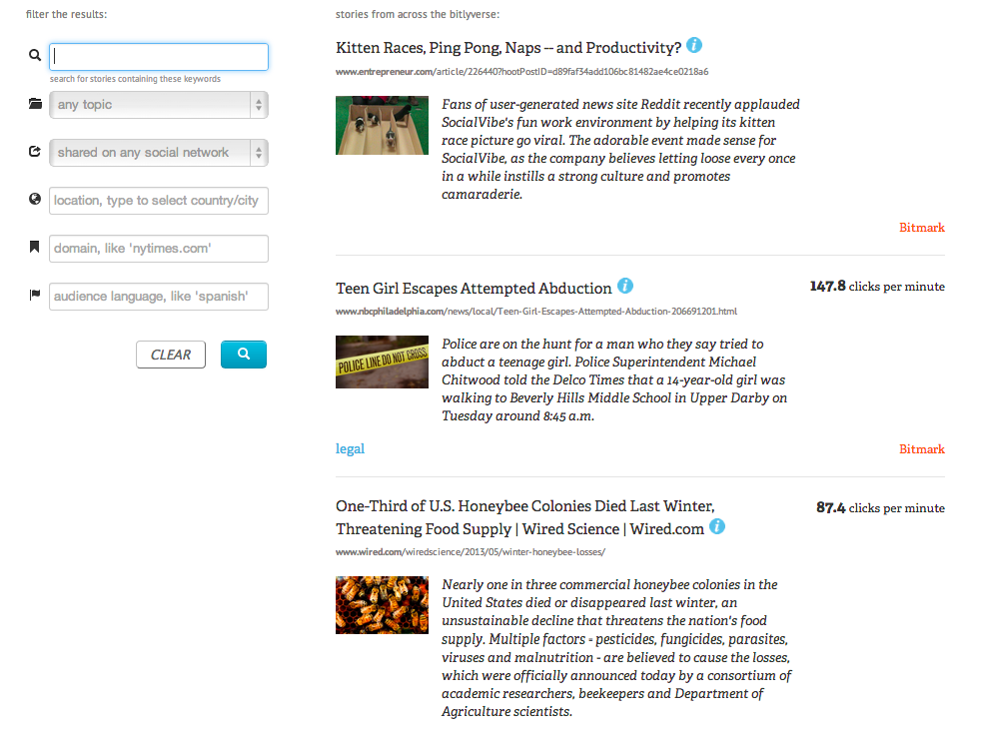
REALTIME, a content discovery engine
Notes:
discover content getting unprecedented amounts of attention
not just relevant but unexpected
trending stories
bursting content

Slide 24
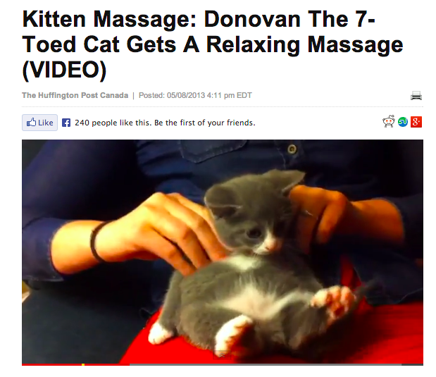
Notes:
so maybe the internet IS ruled by cats (never mind the research)
search solely by topic

Slide 25
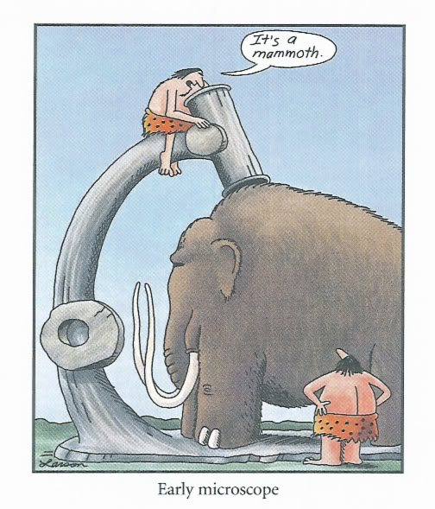
Notes:
audience analysis

Slide 26
bitly
Notes:
audience analysis

Slide 27
bitly
internet
Notes:
well, maybe just part of it
but bitly is on EVERY social network AND more
IM, email, anything people want to track

Slide 28
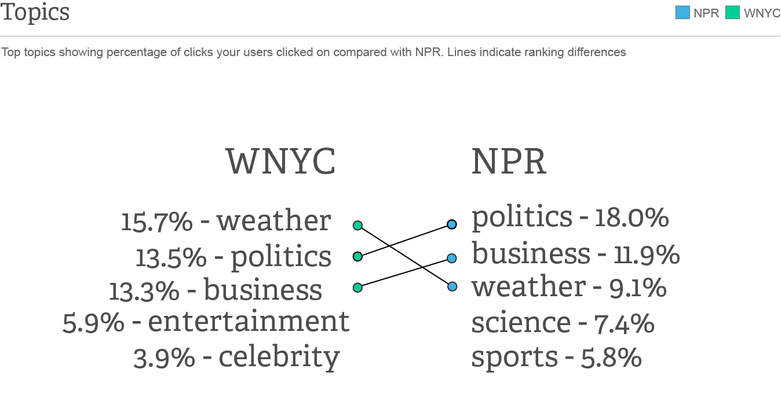
Notes:
simple example - track topics a group of users is looking at
october 2012 - hurricane sandy

Slide 29

Notes:
pretty sure it happened exactly like this

Slide 30
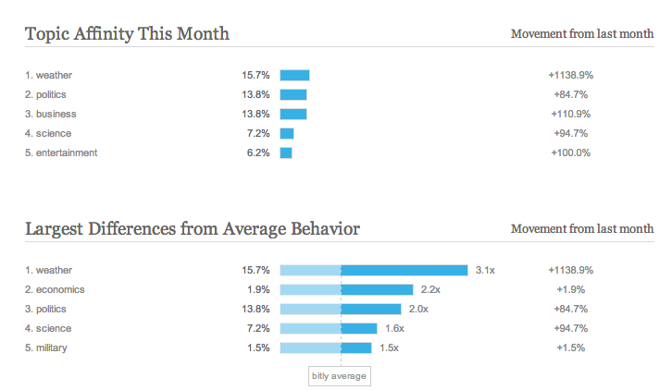
Notes:
psychographics not demographics
comparing yourself versus other people
the click matters - a vote for something not links between pages

Slide 31

Notes:
analyze people based on interests (find your bitly soul mate or anti-soul mate if thats what you are into)
connect phrases to topics -> phrases associated with multiple topics (disambiguating context)

Slide 32
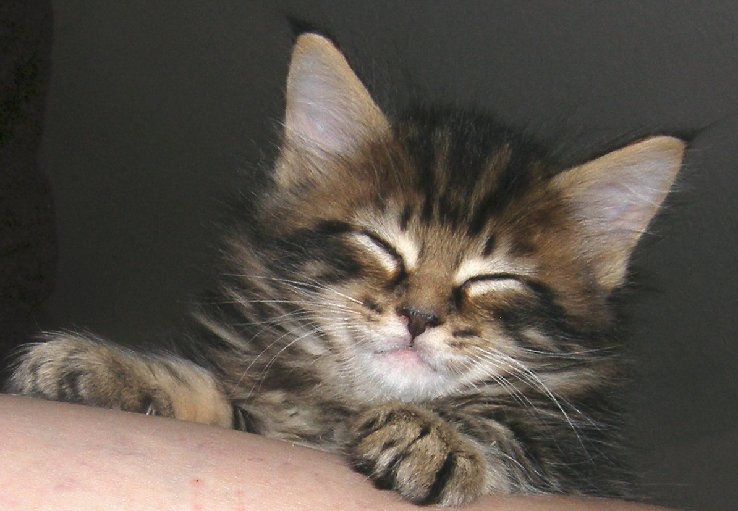
Notes:
gives data more meaning
easy to use (taxonomy, scaling, in dev's control

Slide 33
thanks a bunch!!!
anna@bit.ly
@OMGannaks

